Slide 1

Classifying World Economies
Economic Development Classification Analysis Using International Monetary Fund World Economic Outlook Data
David Blankenship and Jai Vaidya

Slide 2
Project Goals
For our project we wanted to see if we could verify the classification of different countries as Advanced or Developing using real data and see if there are other potential categories being missed. We approached this using two methods:
Supervised, predictive classification of whether a country is a developing/emerging or advanced economy.
Unsupervised clustering to determine if there is another classification schema that could reasonably describe the data or see if the advanced and developing/emerging paradigm appears spontaneously from the data.

Slide 3
Our Dataset
The dataset that we used is the International Monetary Fund (IMF) World Economic Outlook (WEO) dataset.
It is a biannual dataset released by the IMF that is used to project economic forecasts in the near and medium term. In addition to the forecast, it's also a great collection of past economic data collected by the IMF.
It has data past data from 1980 up to 2021 and continues with predictions from there.
It contains 44 features for 196 countries.
For our project we look at the data from 2017 to 2021. The range is chosen for its high proportion of non-null values.
After our initial preprocessing, we will see our datasets shape is 975 by 41; that is 975 instances of country data for those years, 40 features, and 1 target column of 1 or 0 depending on whether the country is an advanced or developing/emerging country.
Of note our dataset is imbalanced with a roughly 4:1 ratio in favor of developing countries.

Slide 4
Preprocessing
The initial shape of the table required significant preprocessing to get into a usable format.
Initially all the data is shaped such that the rows are the features for every country stacked on top of one another while the columns are the years and various columns for the features like units, descriptions and so on.
We reorganized the data such that the features were columns and the rows were instances of a country for a specific year.
Eg USA 2017 would be a row with the data for the USA in 2017.
We converted all national currency dollar amounts into US dollars to allow for comparisons. This also created some duplicate columns which were dropped.
We also elected to drop the ‘employment in persons’ column as this data was only collected for advanced economies and would essentially amount to a data leakage to keep.

Slide 5
Preprocessing
We added a target of 0 or 1 based off of the IMF classification of countries as developing or advanced respectively.
We also found missing data points for various features
We elected to use K-Nearest Neighbors imputation as our imputation strategy.
We also saw that there were several features with heavily skewed tails that would be potential targets for log transformations.

Slide 6
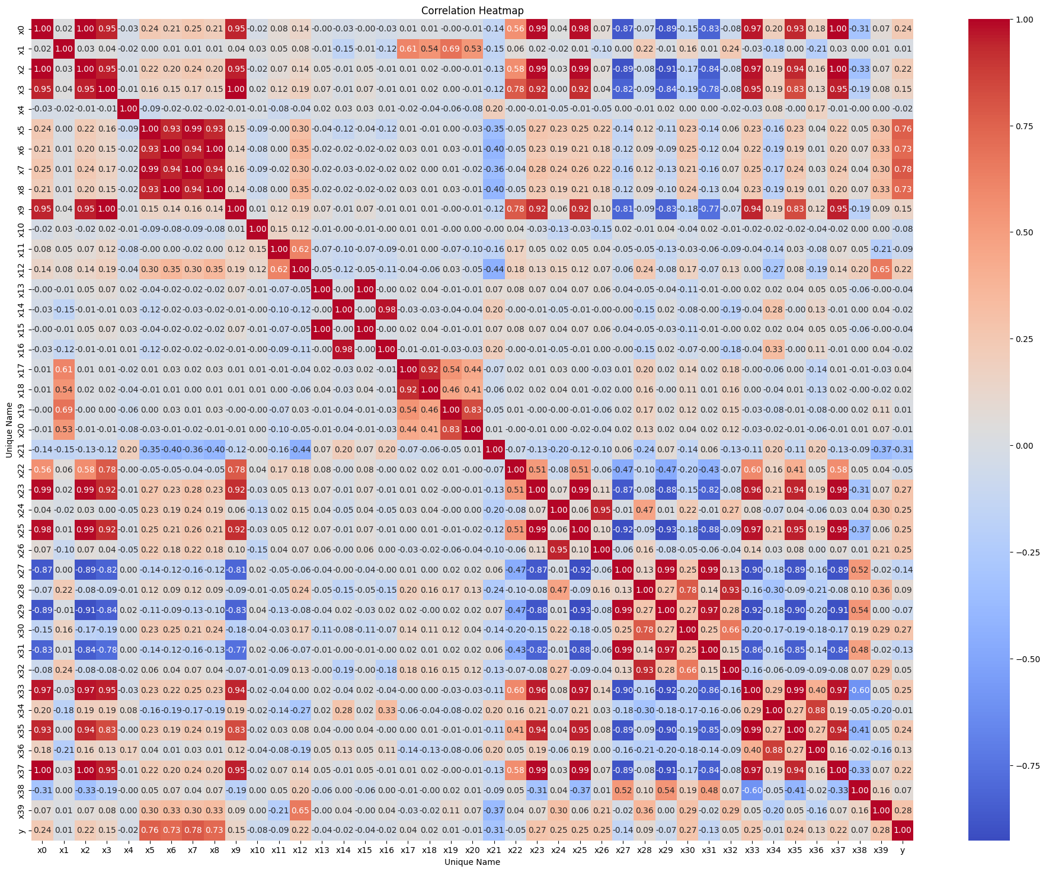
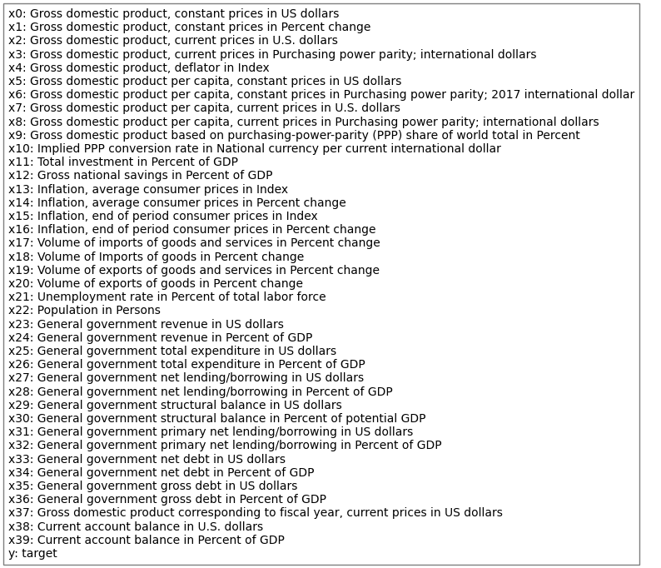
Features

Slide 7
SUPERVISED MODELS

Slide 8
Specific Preprocessing
Logistic Regression
Decision Tree/Random Forest
KNN Imputation with neighbors = 3
4 preprocessing categories
No transform, Standard Scaler
No transform, Robust Scaler
Log transform, Standard Scaler
Log transform, Robust Scaler
We also include Recursive Feature Elimination (RFE) and tweak it as a hyperparameter during our model run.
KNN Imputation with neighbors = 3
Scalers and transforms not required for these.
We also include Recursive Feature Elimination (RFE) and tweak it as a hyperparameter during our model run.

Slide 9
Logistic Regression
Algorithm
Hyperparameters
We elect to use the logistic regression for its simplicity and as a benchmark against more advanced models
Recursive Feature Elimination
Number of features to select: All
Steps: 0.1
Model
Penalty: L1
C: 100

Slide 10
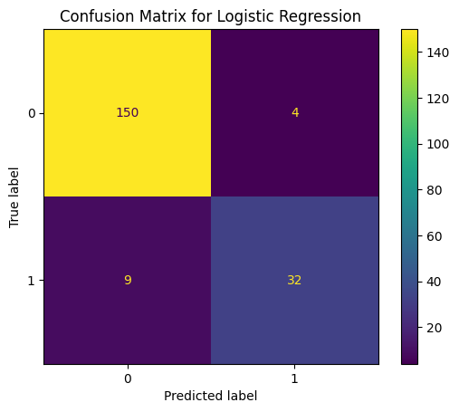
Logistic Regression Test results
We see the logistic model performs quite respectably.
F1 Score | 0.8311
Precision | 0.8889
Recall | 0.7805

Slide 11
Decision Tree
Algorithm
Hyperparameters
Decision Tree is chosen as it is easy to implement requiring no preprocessing
Relatively easy to interpret.
The model selected the following four feature from RFE
Gross domestic product per capita, current prices in U.S. dollars
Gross national savings in Percent of GDP
Inflation, end of period consumer prices in Index
General government revenue in Percent of GDP
Recursive Feature Elimination
Number of features to select: 10%
Steps: 0.5
Model
Max Depth: 10
Minimum Samples Split: 2
Minimum Samples Leaf: 1

Slide 12
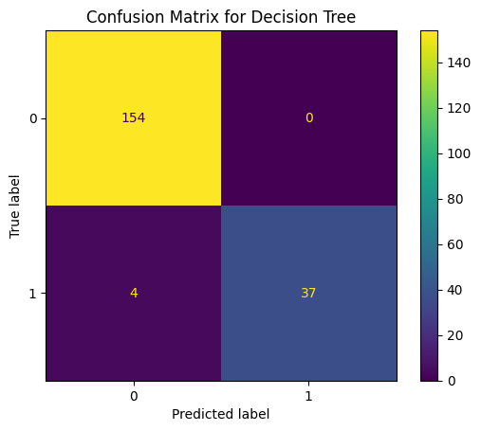
Decision Tree Test results
The decision tree model significantly improves across the board, including a perfect precision.
F1 Score | 0.9487
Precision | 1.0
Recall | 0.9024

Slide 13
Random Forest
Algorithm
Hyperparameters
Similarly to Decision Tree it requires no preprocessing
Introduces ensemble method for additional robustness and generalizability to the prediction.
Recursive Feature Elimination
Number of features to select: 75%
Steps: 1
Model
Max Depth: 10
Minimum Samples Split: 2
Minimum Samples Leaf: 1

Slide 14

Random Forest Eval results
This is our best performing model and only misclassifies one data point in each category.
F1 Score | 0.9756
Precision | 0.9756
Recall | 0.9756

Slide 15
Compare Performance
We see from this table that overall; the Random Forest model was our highest performing model overall
The Decision Tree is able to achieve higher precision at the cost of lower recall.
 | Precision | Recall | F1
Logistic | 0.8889 | 0.7805 | 0.8311
DT | 1.0 | 0.9024 | 0.9487
RF | 0.9756 | 0.9756 | 0.9756

Slide 16
CLUSTERING MODELS

Slide 17
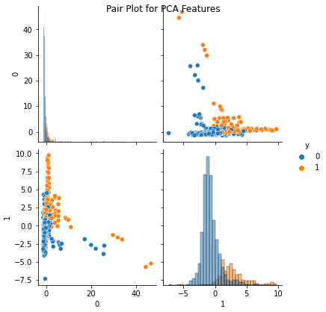
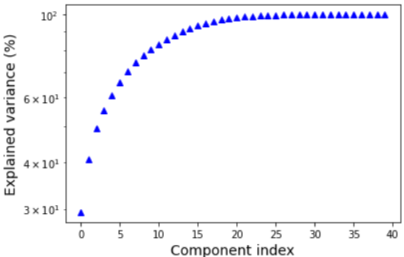
pca
PCA is our first step before running the models to reduce the dimensionality of our data. For visualization's sake, we intend to only use the first 2 components albeit their total explained variance is just over 40%

Slide 18
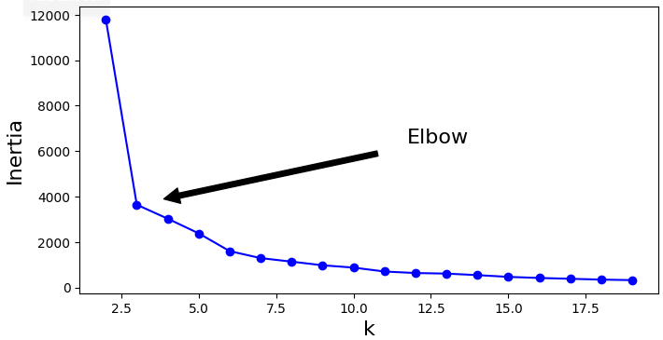
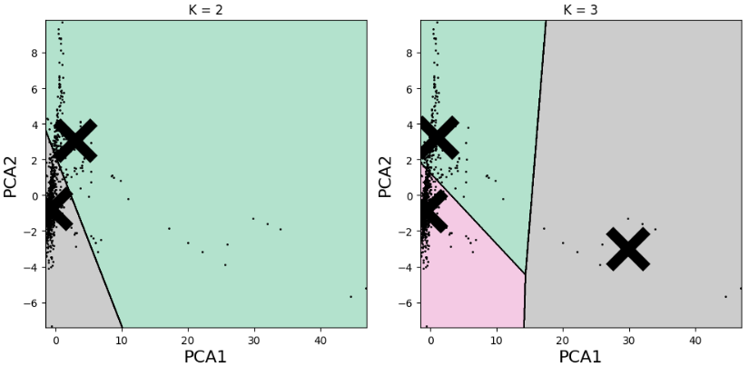
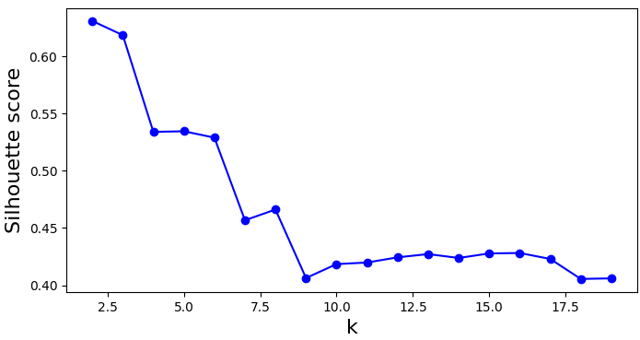
K MEANS CLUSTERING
From the elbow plot and the plot for
silhouette score, it appears that the
optimal number of clusters is 2 - 3.

Slide 19
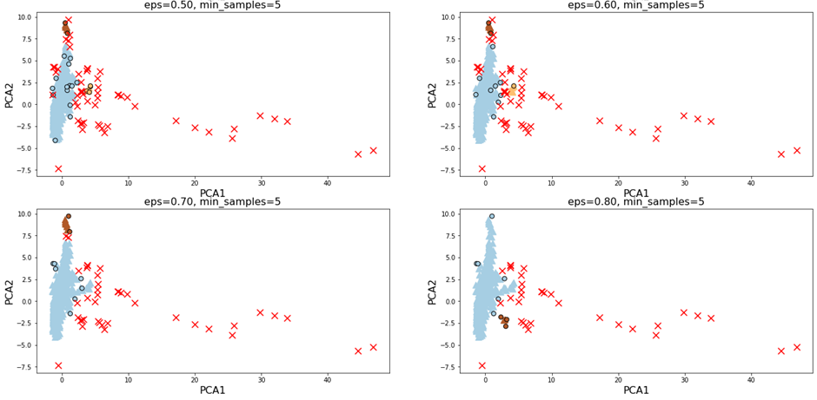
DBSCAN
We used various eps values to ranging from 0.1 to 0.8 in intervals of 0.1. Some of the results clusters obtained are given below

Slide 20
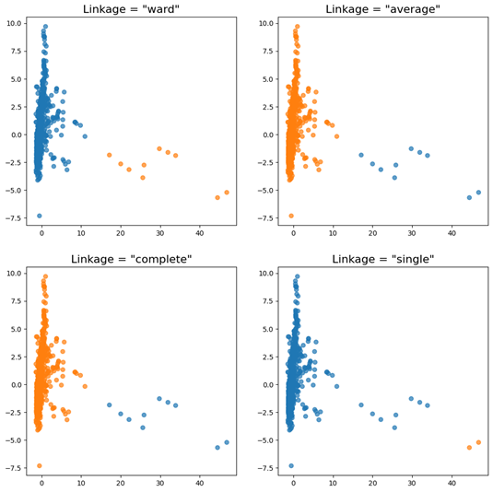
AGGLOMERATIVE CLUSTERING
This model mainly separated the outliers from the bulk of the data
Used 4 types of linkage – ward, average, complete and single to create 2 clusters

Slide 21
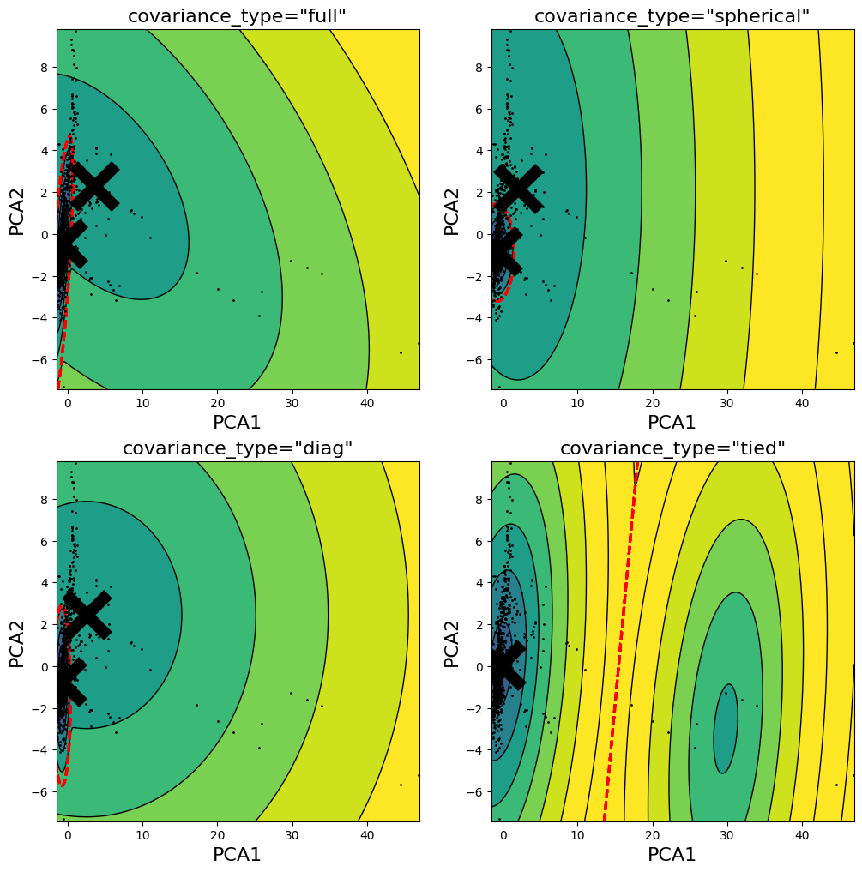
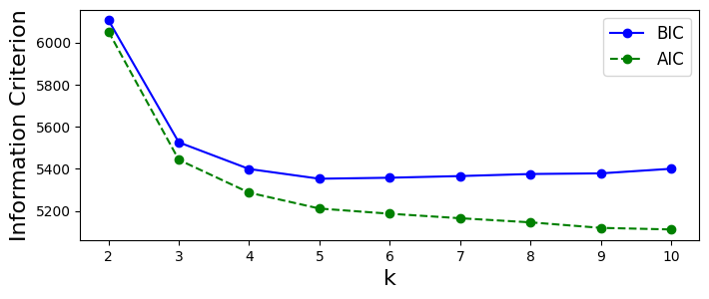
GAUSSIAN MIXTURE
Used 4 types of covariance – full, spherical, diag and tied to create 2 clusters
The 2 clusters of the first 3 covariance type seem to be in the ballpark of the clusters observed in the PCA scatter plot
Based on minimum BIC values, the optimal number of clusters is 5 with full covariance

Slide 22
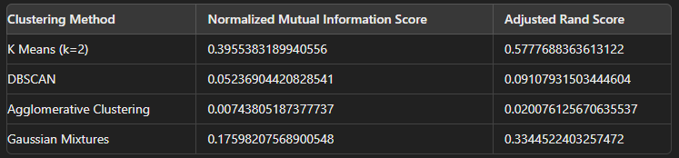
Model EVALUATION
The clustering performance varies significantly across different algorithms. K-Means achieved
the highest scores, indicating moderate alignment with the ground truth labels.
Gaussian Mixtures performed moderately well.
DBSCAN and Agglomerative Clustering showed poor performance, with particularly low scores for Agglomerative Clustering suggesting its clusters are almost random compared to the true labels.
Overall, K-Means proved to be the most effective clustering method for this dataset.

Slide 23
Conclusion, limitations, and Future Work
Overall, we are very satisfied with the results of our project. We set out to verify if the advanced/developing dichotomy was verifiable by the data and we were to find exactly this to a very high degree of fidelity.
This work could also serve as the impetus for several other jumping off points for continued research and exploration.
Incorporating more PCA components and using more advanced clustering models could potentially give better results.
Investigating changeovers in economy classifications https://en.wikipedia.org/wiki/Developed_country
Investigate other classifications/classifiers like WB
WB data particularly interesting!

Slide 24
Work Distribution
Work was distributed evenly amongst the two members
David primarily worked on the supervised models.
Jai primarily worked on the clustering models.

